Slide 1

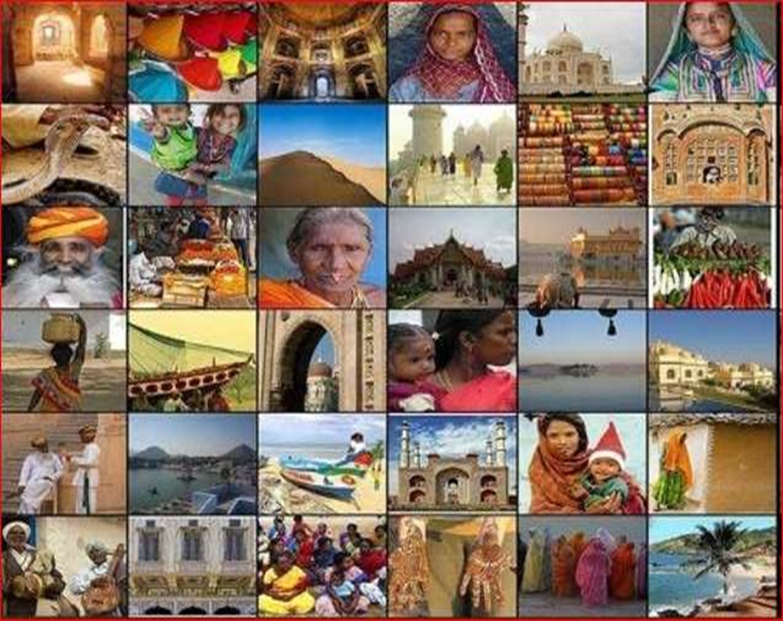
RURAL DEVELOPMENT
Presented by
Sriraksha K,3rd ECE,SMVITM

Slide 2
Content:
Introduction
Problems
What does rural development aim at?
Strategies
Schemes or Yojans

Slide 3
The word rural:
Places away from towns and cities,or a group of people who are traditionalists in outlook,rooted to their land and people who resist change.
Villages are the heart of India .
75% of India’s population is in rural areas,having 13.5 crore households.

Slide 4
The UN defines
Rural Development as:
“Rural Development is a process of change, by which the efforts of the people themselves are united, those of government authorities to improve their economic, social and cultural conditions of communities in to the life of the nation and to enable them to contribute fully to national programme.”

Slide 5


Rural Development is the process of improving the social,economic, and cultural conditions of a village or small town.
Rural development is a strategy designed to improve the economic and social life of rural poor. It is a process, which aims at improving the well being and self realization of people living outside the urbanized areas through collective process.
Rural Development is all about bringing change among rural community from the traditional way of living to progressive way of living. It is also expressed as a movement for progress.

Slide 6
PROBLEMS IN RURAL REGIONS PEOPLE RELATED PROBLEMS
1.Traditional way of thinking.
2.Poor understanding.
3.Low level of education to understand developmental efforts and new technology.
4.Deprived psychology and scientific orientation.
5.Lack of confidence.
6.Poor awareness.
7.Existence of unfelt needs.
8.Personal ego.

Slide 7
AGRO RELATED PROBLEM
1.Lack of expected awareness ,knowledge ,skill and attitude. 2.Unavailability of inputs.
Poor marketing facility.
Insufficient extension of staff and services.
Multidimensional tasks to extension personnel. 6.Small size of landholding
7.Division of land.
8.Unwillingness to work and stay in rural areas.

Slide 8
INFASTRUCTRAL RELATED PROB.
Poor infrastructure facilities like Water,Electricity,Transport,Educational institutions,Communication,Health,Employment,Storage facility etc.
ECONOMIC PROBLEMS
1.Unfavourable economic condition to adopt high cost technology.
2.High cost of inputs.
3.Underprivileged rural industries

Slide 9

LEADERSHIP RELATED PROBLEM
1.Leadership among the hands of inactive and incompetent people. 2.Selfinterest of leaders.
3.Biased political will
Political interference.
Lack of motivation and interest. 3.Unwillingness to work in villages. 4.Improper utilization of budget.
5.No proper monitoring of programs and lacking their implementation.

Slide 10

Infrastructure
Public Service
To Build
Communication
Education
Health
To improve
Living condition
Employment
Farm & storage Economical activities
To generate

Slide 11
Principles of Strategy
Production not a Challenge – productivity is.
De-risk Agriculture
Monetise the Output
Address structural issues
Sustainability to form the basis

Slide 12


Slide 13
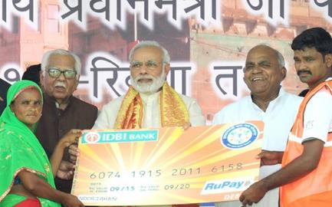



v
DEVELOPMENT FOR ALL
Jan Dhan Yojana Serving the Banking Needs of the Unbanked
34.03 Crore
Jan Dhan accounts opened
According to the World Bank Findex Report, India accounts for
55% of new bank accounts opened globally between 2014-17
India Post Payments Bank launched taking banking system to doorstep of poor & unbanked. Over 1.25 Lakh Access Points rolled out in 4 months
As on 1st February 2019

Slide 14
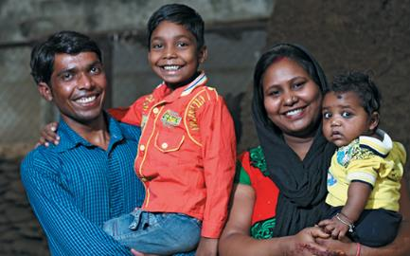




v
DEVELOPMENT FOR ALL
Jan Suraksha Yojana Gives Insurance to Poor
14.64 crore persons insured under PM Suraksha Bima Yojana at ₹12 per year
PM Jeevan Jyoti Bima Yojana benefitted 5.67 crore families at ₹330 per year
Atal Pension Yojana, for unorganised sector workers, has more than 1.37 crore subscribers
Financial security of senior citizens with PM Vaya Vandana Yojana, gives 8% interest for 10 years. Investment limit doubled to ₹15 lakh and scheme extended till 2020
As on 1st February 2019

Slide 15
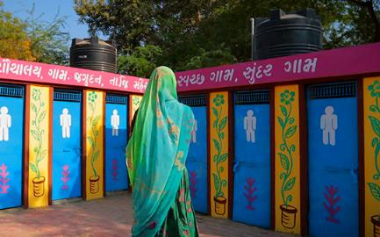



v
DEVELOPMENT FOR ALL
Swachh Bharat Mission Brings about a Sanitation Revolution
Rapid construction of toilets ensuring dignity of women & eradicating open defecation
Over 5.48 lakh Villages in 27 States & UTs declared Open Defecation Free
Over 9.74 crore
Toilets built
Sanitation coverage increased from 38.70% in 2014 to 98.82% at present
As on 1st February 2019

Slide 16
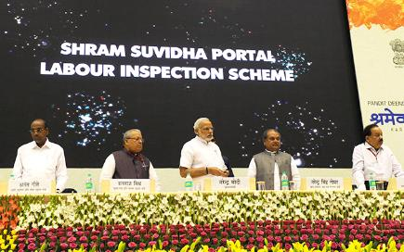




v
DEVELOPMENT FOR ALL
Shramev Jayate: Upholding Dignity of Labour
Budget 2019-20 Proposal
PM Shram Yogi Maandhan Yojana
Under NPS, share of
Government increased to 14%
To provide assured monthly pension of ₹3000 after 60 years of age with monthly contribution of ₹100
Max. ceiling of Bonus for labour increased from ₹3500 to ₹7000 per month & gratuity ceiling increased from ₹10 lakh to ₹20 lakh
Overdraft limit
raised from
`5000 to `10,000
No conditions for
overdraft
up to `2000
Age limit for availing
overdraft facility increased from
18-60 to 18-65 years
To benefit 10 crore workers in unorganized sector
In case of death, withdrawal limit from EPFO increased from ₹2.5 lakh to ₹ 6 lakh
As on 1st February 2019

Slide 17
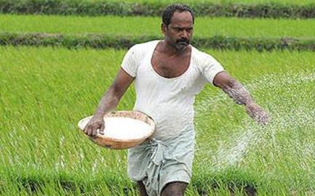






PUTTING FARMERS FIRST
Greater Access and Availability of Fertilizers
100 % Neem Coating resulted in improvement in soil health, reduction in pest and disease attack
Led to Increased Nitrogen Use Efficiency and increased crop yield
Special Banking arrangement of ₹10,000 cr to clear fertilizer subsidy dues
Significant increase in Urea
Production with New Urea Policy
A reduction in the MRP of DAP*, MOP** and Complex fertilizers
*Diammonium Phosphate
**Muriate of Potash
As on 1st February 2019

Slide 18





PUTTING FARMERS FIRST
Helping Farmers get the
Right Price
Electronic National Agriculture Market e-NAM
e- Trading platforms,
585 regulated markets to fetch best prices for farmers
More than 1.47 crore farmers
and sellers are registered
Over 2.31 crore tonnes of farm commodities worth ₹61,098 crore transacted on e-NAM
As on 1st February 2019

Slide 19
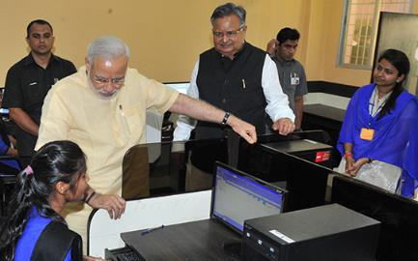
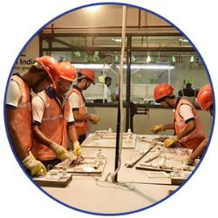
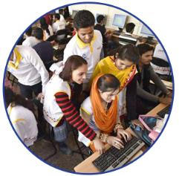
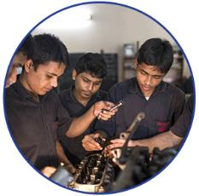

HARNESSING YUVA SHAKTI
Augmenting the Arena of Skill
Development & Vocational Training
Pradhan Mantri Kaushal Vikas Yojana
On average, 1 crore youngsters trained every year
Over 13,000 training centres opened across India training in 375 trades
PM Kaushal Kendras
(PMKK) are being set up in every district across India
As on 1st February 2019

Slide 20
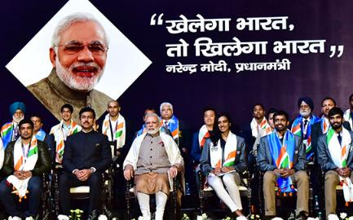





HARNESSING YUVA SHAKTI
Furthering Sports & Sportsmanship Khelo India
Financial assistance of ₹5 lakh/annum for 8 years to talented players
First Khelo India School Games launched on Jan 2018, 3507 players from 29 States and 7 UTs participated
Revamped Khelo India program to have a financial outlay of
₹1,756 crore for 2017-18 to 2019-20
Sports Talent Search Portal launched
A transparent platform for talented youth to share their achievements
As on 1st February 2019

Slide 21
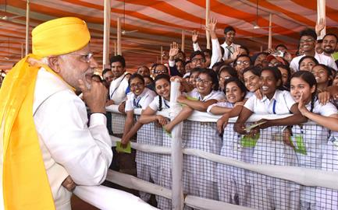





WOMEN LED DEVELOPMENT
From Women Development to Women-led development
Beti Bachao, Beti Padhao
Sex ratio at birth improved
in 104 identified districts
Rising enrollment
of girls in secondary schools
Multiple scholarship
for education of girls
119 districts have reported progress in first trimester registration
146 districts
have reported improvement
in institutional deliveries
As on 1st February 2019

Slide 22
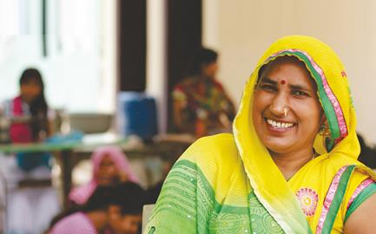






WOMEN LED DEVELOPMENT
Supplementing skills and supplying capital for Nari Shakti
This scheme provides collateral free loans to entrepreneurs
This initiative provides loans of up to ₹1 crore to women /SC/ST/OBC entrepreneurs
Over 9 crore women constituting over 74% of the beneficiaries, benefitted jointly from Mudra & Stand-Up India
Government PSUs to purchase 3% of material from enterprises owned by women
As on 1st February 2019

Slide 23
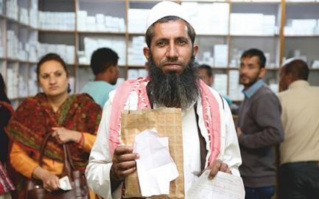




t
HEALTHY INDIA
Health insurance
cover of up to
₹ 5 lakh/family/yea
Ensuring Affordable & Quality Healthcare
1084 essential medicines brought under Price Control regime giving consumer total benefit of more than ₹15,000 crore
Price of Cardiac Stents reduced by 85% resulted in annual saving of ₹46,000 crore
Affordable medicines with PM Bhartiya
Janaushadhi Kendras. More than 4,900 stores, resulting in savings of over 50%-90%
Price of Knee Implants reduced by 69% resulted in annual saving of ₹ 1,500 crore
AMRIT pharmacies provide drugs for cancer &
cardiovascular diseases at a discount of 60% to 90%
Over 1.04 crore patients have benefitted (as on 30 Nov.2018)
As on 1st February 2019

Slide 24
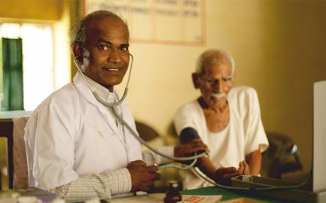



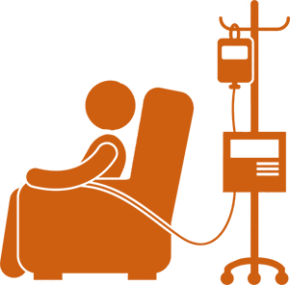


t
HEALTHY INDIA
Health insurance
cover of up to
₹ 5 lakh/family/yea
Quality and Affordable Health
Provide free dialysis
services to poor &
subsidized services
to all patients
647 dialysis units and 3953 Dialysis machines made operational
Pradhan Mantri National
Dialysis Program
About 2.5 lakh
patients have availed the service
Nearly 35 lakh
dialysis session
held so far
As on 1st February 2019

Slide 25
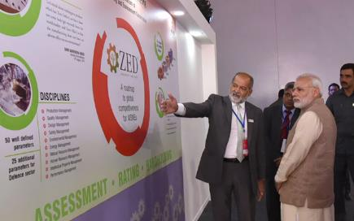



ACCELERATING GROWTH
Making MSME the Future Growth Engines
Budget 2019-20 Proposal
Atleast 3% of the
25% sourcing
for Government undertakings to be from women owned SMEs
2% interest subvention on an incremental
loan of ₹ 1 crore for GST registered MSMEs
Businesses comprising over 90% of GST payers to be allowed to file quarterly return
As on 1st February 2019

Slide 26
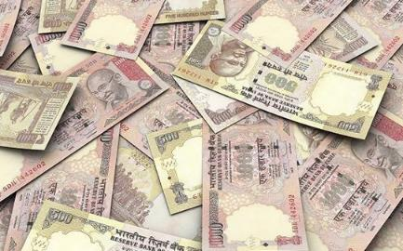









SPEED & SCALE OF TRANSFORMATION
Demonetisation Boosts Formalisation of Economy
₹5730 Cr
A Quantum Leap in Digital Payments
₹102595 Cr
₹7589 Cr
₹7393 Cr
₹3448 Cr
₹800 Cr
₹300 Cr
₹2 Cr
₹50 Cr
Oct. 2016
Dec. 2018
Before
Demonetisation
Dec. 2018
Before
Demonetisation
Dec. 2018
Sept. 2016
Dec. 2018
BHIM transactions
UPI transactions
Point of Sale (PoS) transactions
E-Commerce transactions
As on 1st February 2019

Slide 27
Few Other Schemes
1. Soil Health Management
Setting up of new soil testing laboratories and strengthening the existing labs.
2. Pradhan Mantri Krishi Sinchayee Yojana (PMKSY)
Drought and increasing irrigation
3. National Food Security Mission (NFSM)
Promotes & extends improved technologies, i.e., Seed, Micro Nutrient, Soil Amendments, Integrated Pest Management, Farm Machinery & Implements, Irrigation Devices, Capacity Building of Farmers.

Slide 28
Flagship Schemes
3. e-NAM
4. Pradhan Mantri Fasal Bima Yojana (PMFBY)
Available to farmers at very low rates of premium.
Farmers to get full insurance. No capping of sum insured.
Insurance cover at all stages of crop cycle.
Focus on covering non-loanee along with loanee farmers.
Target for area coverage 40% (2017-18) and 50% (2018-19)

Slide 29
Flagship Schemes
6. . Rashtriya Krishi Vikas Yojana (RKVY - RAFTAAR)
Incentivise States to increase public investment in agriculture & allied sectors
Provide flexibility & autonomy to States in process of planning and executing schemes.
Focus on pre and post-harvest infrastructure, integrated value chains
7. Mission for Integrated Development of Horticulture (MIDH)
Launched on 1st April 2014 for holistic growth of horticulture sector.
Includes supply of quality planting material, technology promotion, productivity improvement, human resource development, creation of post-harvest management infrastructure.

Slide 30


Swarnjayanti Gram Swarozgar Yojana (SGSY)
Self employment programme for the rural poor.
The assisted
families (Swarozgaris) may be
individuals or groups (Self-Help Groups).
Emphasis is on the group approach
To bring the assisted poor families above the poverty line by providing them income generating assets through a mix of bank credits and government subsidy.
Organization of poor into Self-Help Groups and taking care of training, credit, technology infrastructure and marketing.
Implemented by the District Rural Development Agencies (DRDAs) with the active participation of Banks, the line Departments, and NGO’s

Slide 31

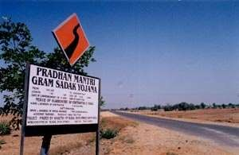
Pradhan Mantri Gram Sadak Yojana (PMGSY)
Launched December,
2000 100%
centrally sponsored scheme to
provide connectivity to unconnected
habitations Road connectivity to all
habitations with a population of
thousand (500 in case of hilly or tribal areas) with all weather roads by 2009
lead to rural
employment
opportunities, better access to
regulated and fair market, better
access to health, education and other public services
Bridge the rural-urban divide and pave
the path of economic growth.

Slide 32





The scheme provides for free of cost connection to all rural households living below poverty line. Further, there will no discrimination in the hours of supply between rural and urban areas.
The scheme also lays special emphasis on sustainability of rural supply through collection of the cost of electricity from the beneficiaries.
The scheme has a target of electrifying 1,25,000 un-electrified villages and giving access to 7.8 crore uncovered rural households in next 5 years.

Slide 33
Thank You

